Slide 1

WMDA Global trends report 2020
WMDA Search & Match Service

Slide 2

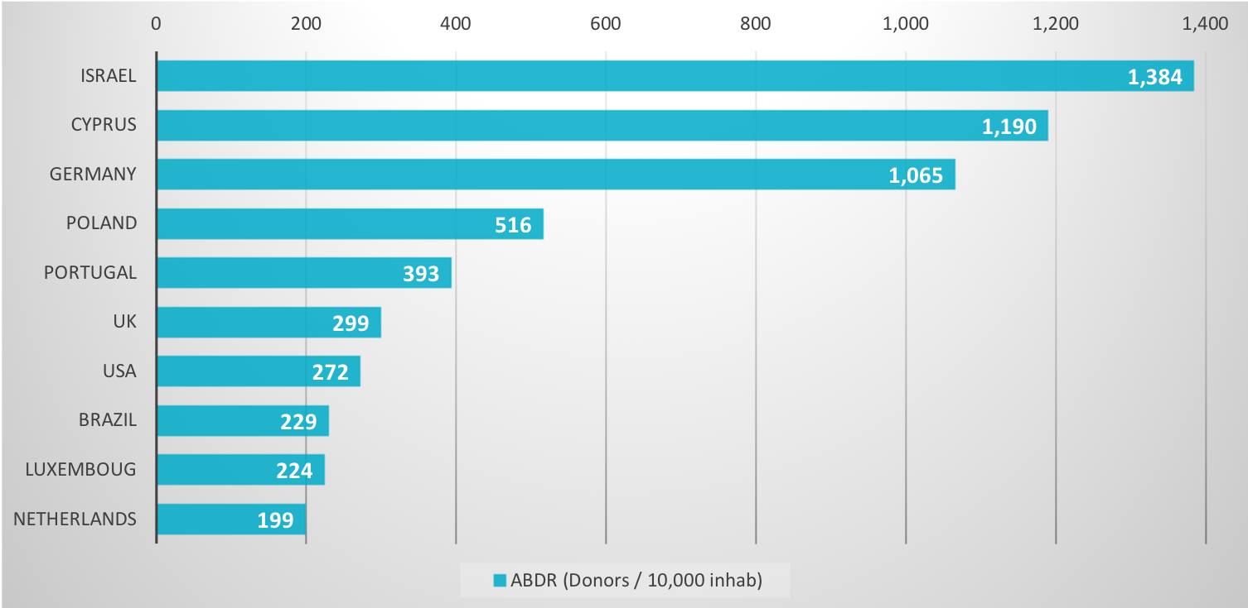
No. of unrelated donors listed per 10,000 inhabitants (top 10) in
WMDA Search & Match Service in 2020

Slide 3
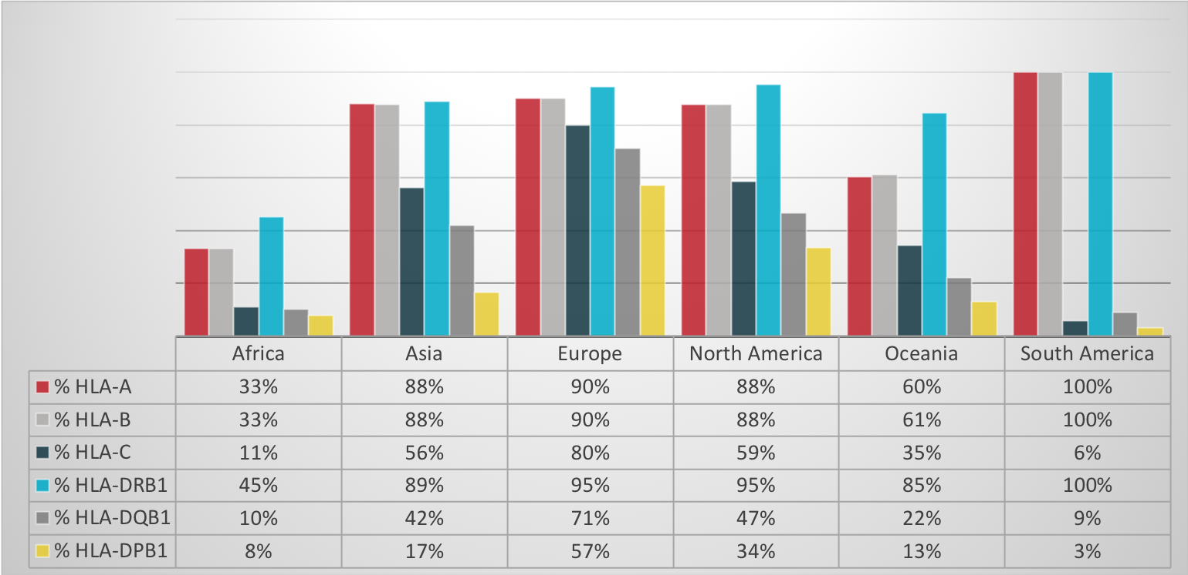
Percentage HLA DNA typed unrelated donors in
WMDA Search & Match Service in 2020

Slide 4
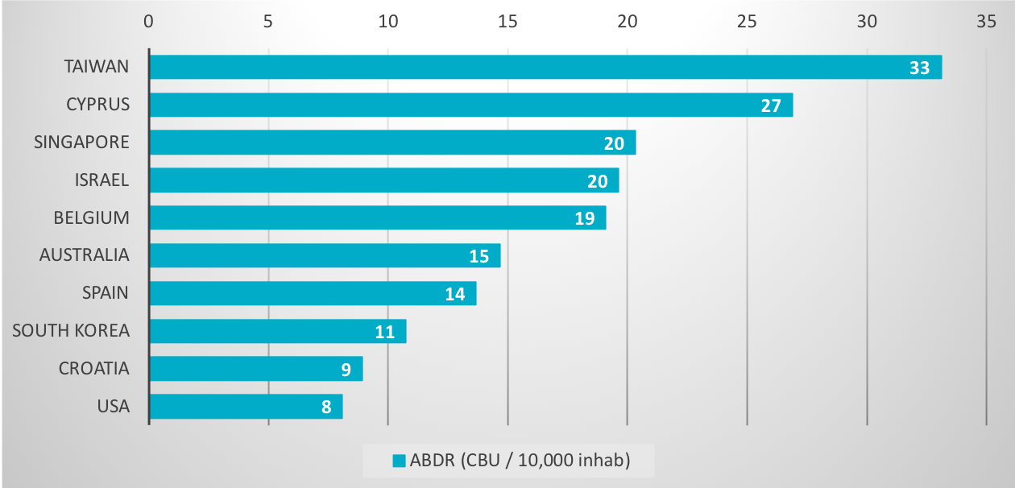
No. of cord blood units listed per 10,000 inhabitants (top 10) in
WMDA Search & Match Service in 2020

Slide 5
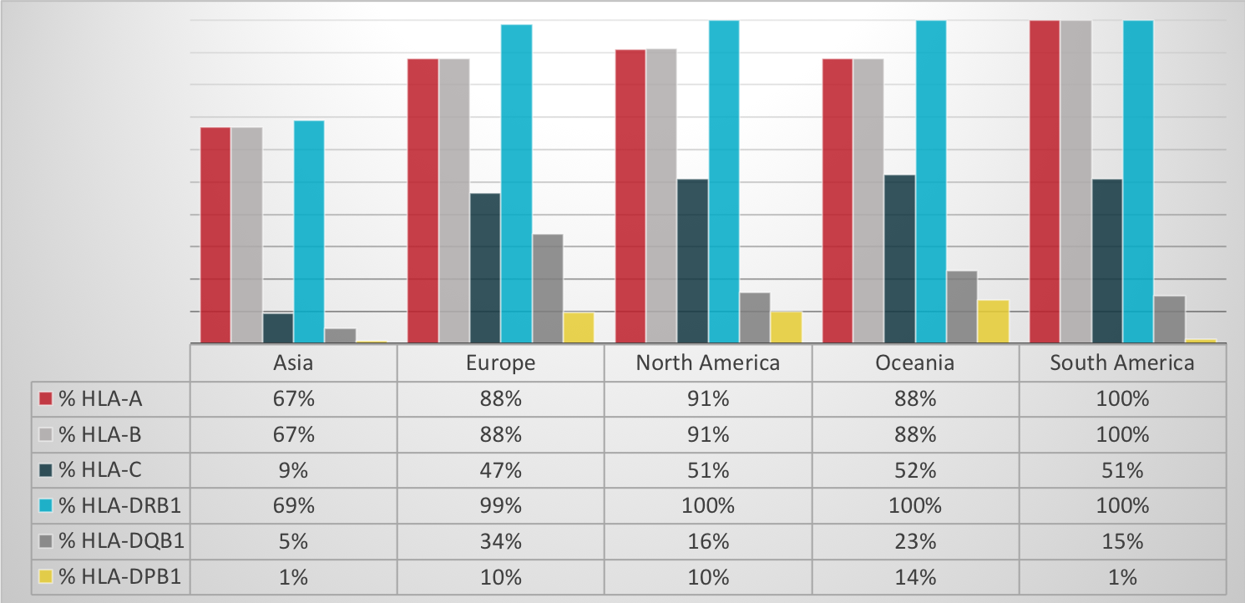
Percentage HLA DNA typed cord blood units in
WMDA Search & Match Service in 2020

Slide 6
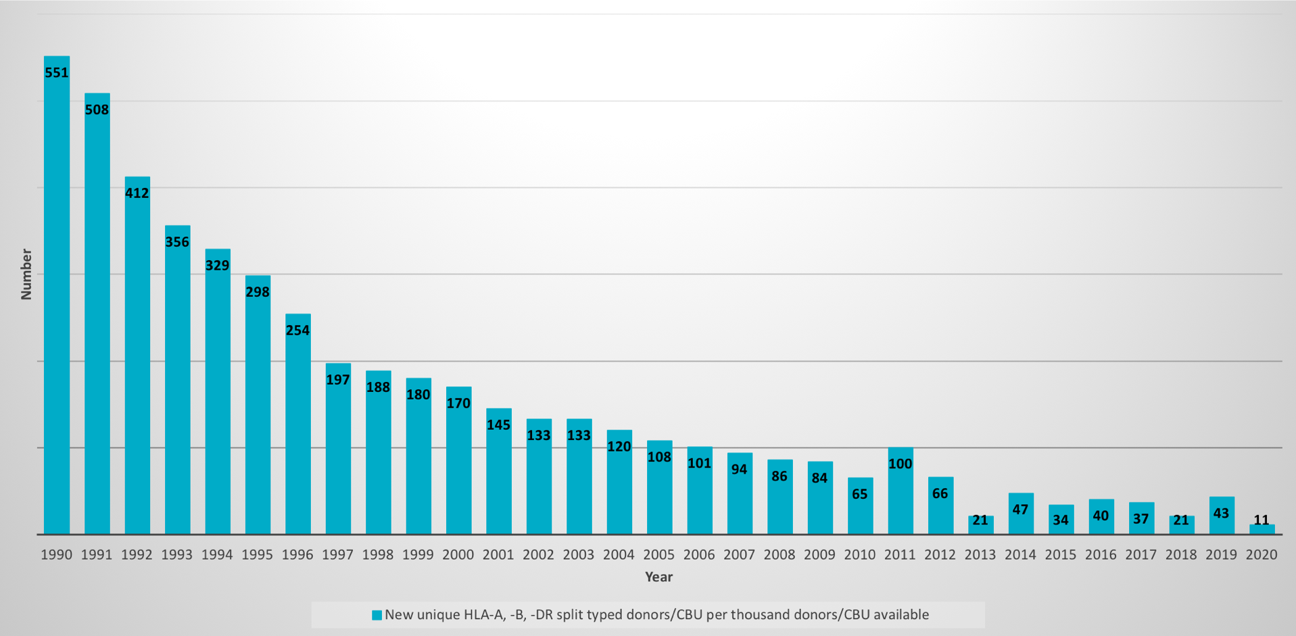
No. of unique ABDR split unrelated donors/cord blood units
added to WMDA Search & Match Service in 2020

Slide 7
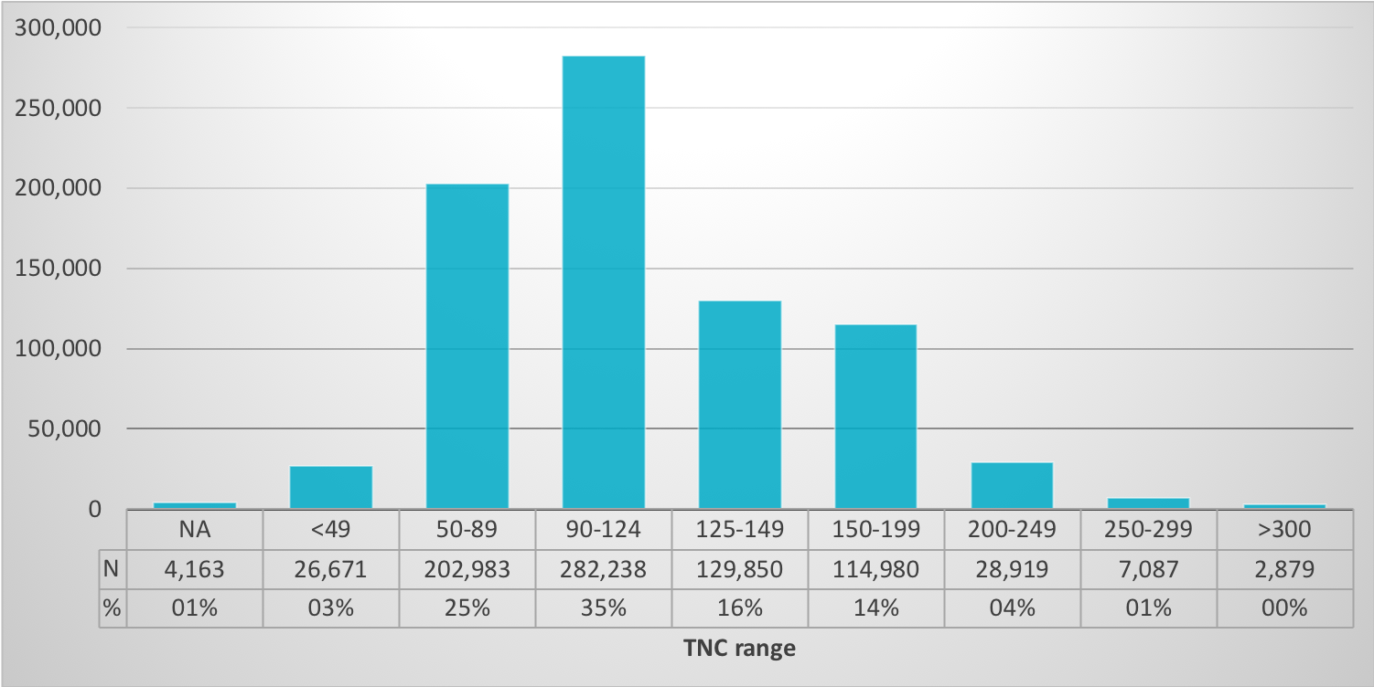
Percentage and number per TNC range of listed cord blood units in
WMDA Search & Match Service in 2020

Slide 8
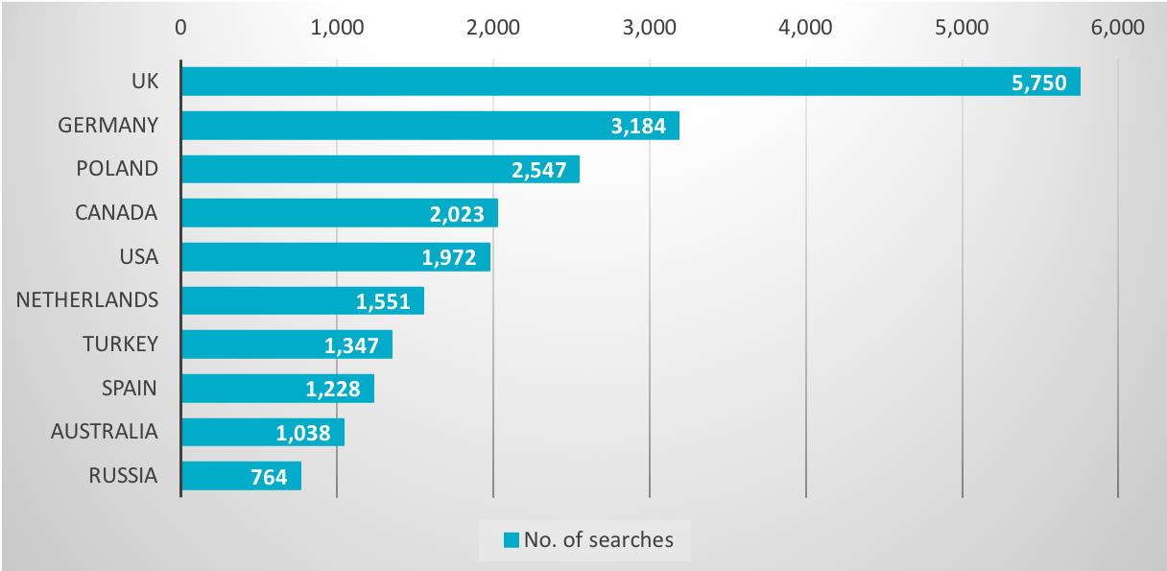
No. of unrelated donor/cord blood unit searches per country in
WMDA Search & Match Service in 2020 (top 10)

Slide 9
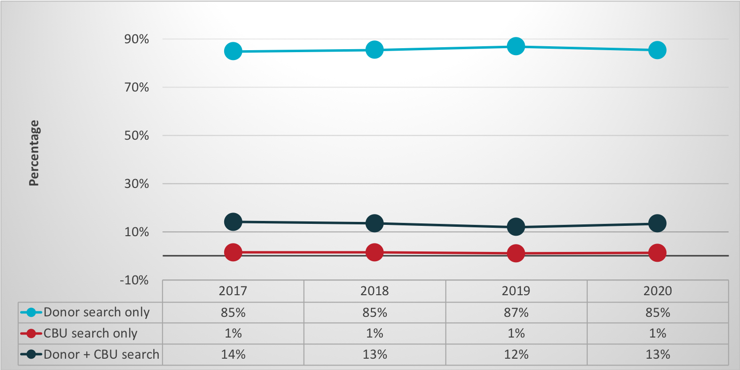
Search types in WMDA Search & Match Service
from 2017-2020

Slide 10
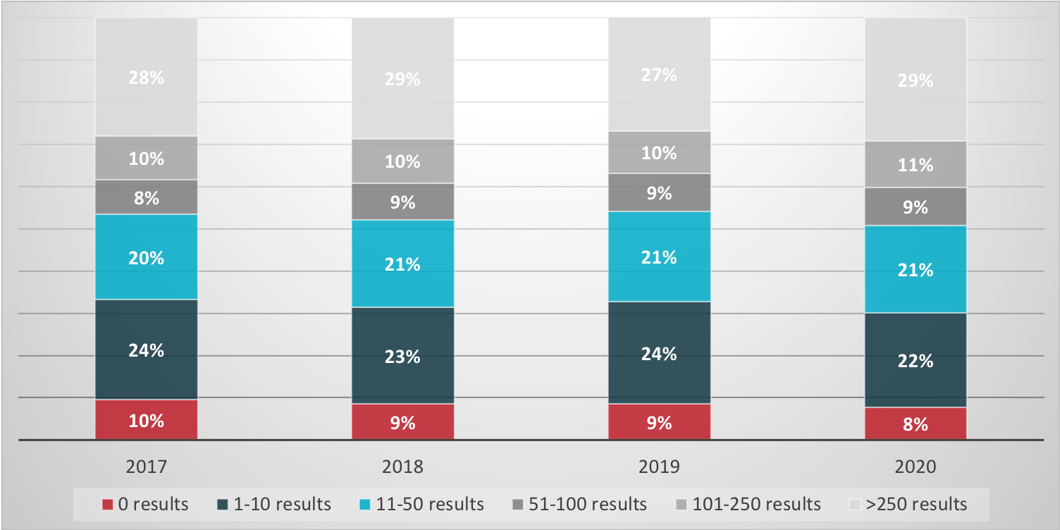
Search results in WMDA Search & Match Service
from 2017-2020

